Slide 1
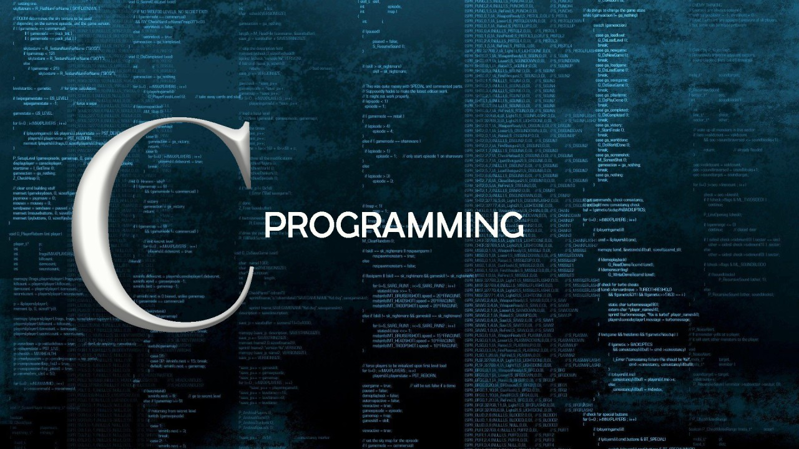
Sailing the Sea Of C

Slide 2
Today’s Motivation
No matter how big the dream is — the hardest part is to just begin. The moment you take that first step, you're already ahead of 50% of the world. Most people keep waiting for the “right time” — but you? You showed up. Starting isn’t just important, it’s powerful. Because every legend was once just a beginner who dared to start.

Slide 3
Block Diagram of a Computer
It is a pictorial representation of a computer which shows how computer works
It shows how computer works from getting input to showing output.

Slide 4
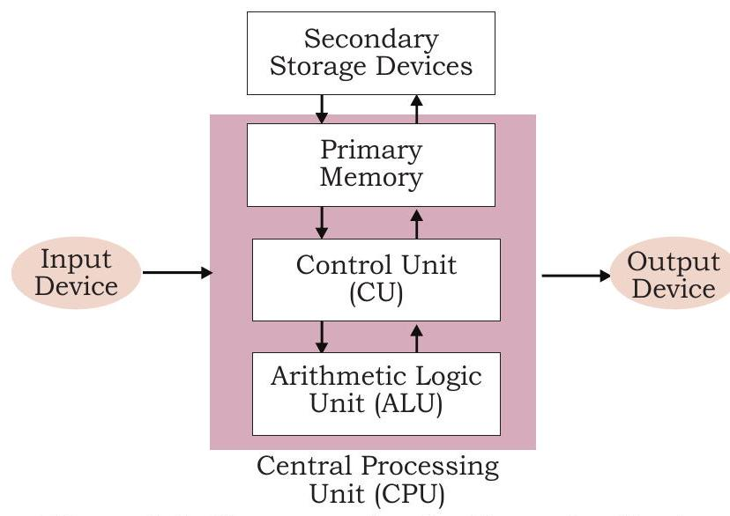
Diagram

Slide 5
Input Devices
The devices used to enter data in to computer system are called input devices.
It converts human understandable input to computer controllable data.
CPU accepts information from user through input devices.
Examples: Mouse, Keyboard, Touch screen, Joystick etc...

Slide 6
Output Devices
The devices used to send the information to the outside world from the computer is called output devices.
It converts data stored in 1s and Os in computer to human understandable information.
Examples: Monitor, Printer, Plotter, Speakers etc...

Slide 7
CPU (Central Processing Unit)
It contains electronics circuit that processes the data based on instructions. It also controls the flow of data in the system.
It is also known as brain of the computer.
CPU consists of,
1. Arithmetic Logic Unit (ALU)
It performs all arithmetic calculations such as add, subtract, multiply, compare, etc. and takes logical decision.
It takes data from memory unit and returns data to memory unit, generally primary memory (RAM).
2. Control Unit (CU)
It controls all other units in the computer system. It manages all operations such as reads instruction and data from memory.

Slide 8
Primary Memory
It is also known as main memory.
The processor or the CPU directly stores and retrieves information from it. Generally currently executing programs and data are stored in primary memory.
Secondary Memory
Secondary memory is also called Auxiliary memory or External memory.
It is Used to store data permanently.
It can be modified easily.
It can store large data compared to primary memory. Now days, it is available in Terabytes.
Examples: Hard disk, Floppy disk, CD, DVD, Pen drive, etc...

Slide 9
Compiler Vs Interpreter Vs Assembler
Compiler translates program of higher level language to machine language. It converts whole program at a time.
Interpreter translates program of higher level language to machine language. It converts the code line by line.
Assembler translates program of assembly language to machine language.

Slide 10
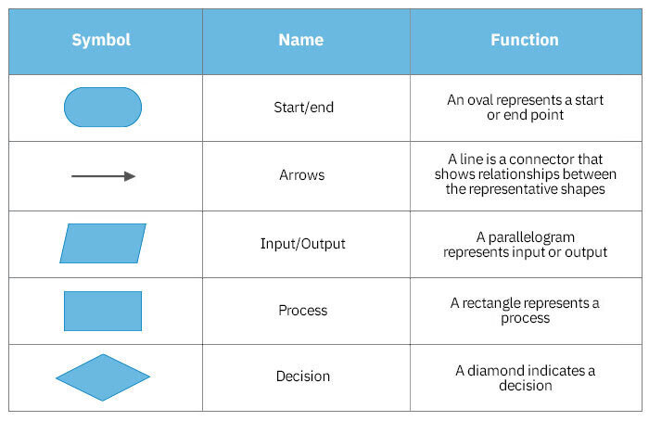
Flowchart Symbols

Slide 11
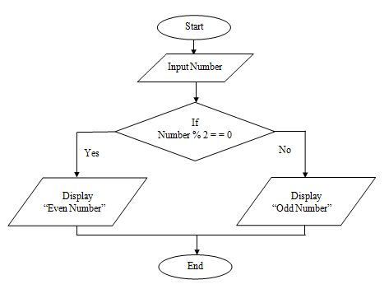
Flow Chart To Check Number Even or Odd
Step 1: Start
Step 2: Read Number
Step 3: If Number % 2 equal zero, go to step 4.
Step 4: Print Odd Number, go to step 5.
Step 5: Print Even Number.
Step 6: Stop.

Slide 12
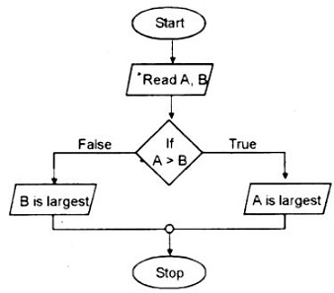
Flow Chart To Find largest of Two number
Step 1: Start
Step 2: Read no.
Step 3: If A > B, go to step 4.
Step 4: Print B is the largest number, go to step 5.
Step 5: Print A is the largest number.
Step 6: Stop.

Slide 13
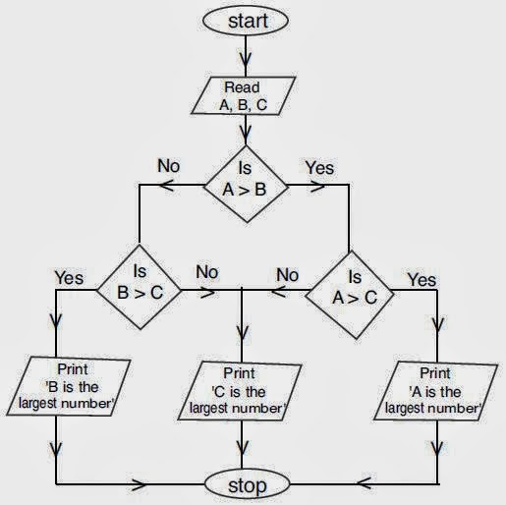
Flowchart Of Largest Of Three

Slide 14
Largest Of Three (Algorithm)
Step 1: Read a, b, c.
Step 2: If a>b, go to step 5.
Step 3: If b>c, go to step 8.
Step 4: Print c is largest number, go to step 9.
Step 5: If a>c, go to step 7.
Step 6: Print c is largest number, go to step 9.
Step 7: Print a is largest number, go to step 9.
Step 8: Print b is largest number.
Step 9: Stop.

Slide 15
Fundamentals of
C

Slide 16
What is C?
C is a general-purpose programming language created by Dennis Ritchie at Bell Laboratories in 1972.
Despite its age, C remains highly popular due to its fundamental role in computer science.
Strongly associated with UNIX, as it was developed to write the UNIX operating system.

Slide 17
Why Learn C?
One of the most popular programming languages in the world.
Knowledge of C facilitates learning other languages like Java, Python, C++, and C# due to similar syntax.
C is very fast compared to other languages such as Java and Python.
Versatile: used in both applications and technologies.

Slide 18
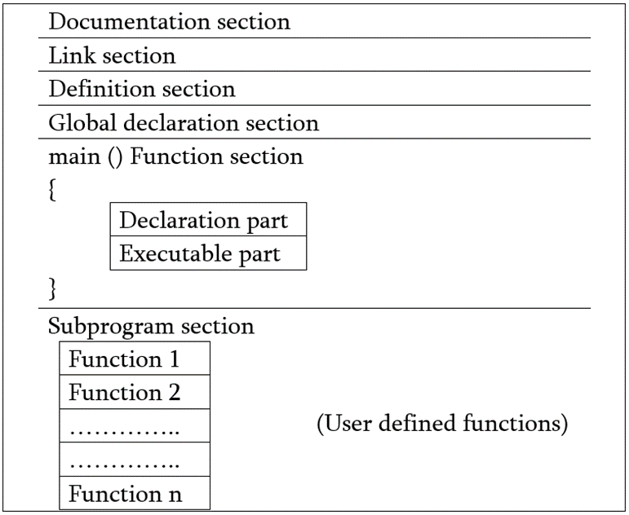
Structure of C
Documentation Section
Provides an overview of the program: Includes title, author, and summary information.
Uses comment lines: Helps in understanding the program's purpose and functionality.
Link Section / Header File Declaration Section
It Links Compiler to Link Functions from System Library

Slide 19
Definition Section
Defines Symbolic Constants
Eg. #define Pi 3.14
Global Declaration Section
Variables that are accessed by one or more functions are called Global Variable
Global Variables are declared in this Section
Main function Section
Used to start of actual C program
It includes two parts as declaration part and executable part
Subprogram Section
It has all User-defined Functions that are called in main
User Defined Functions are generally placed immediately after main

Slide 20
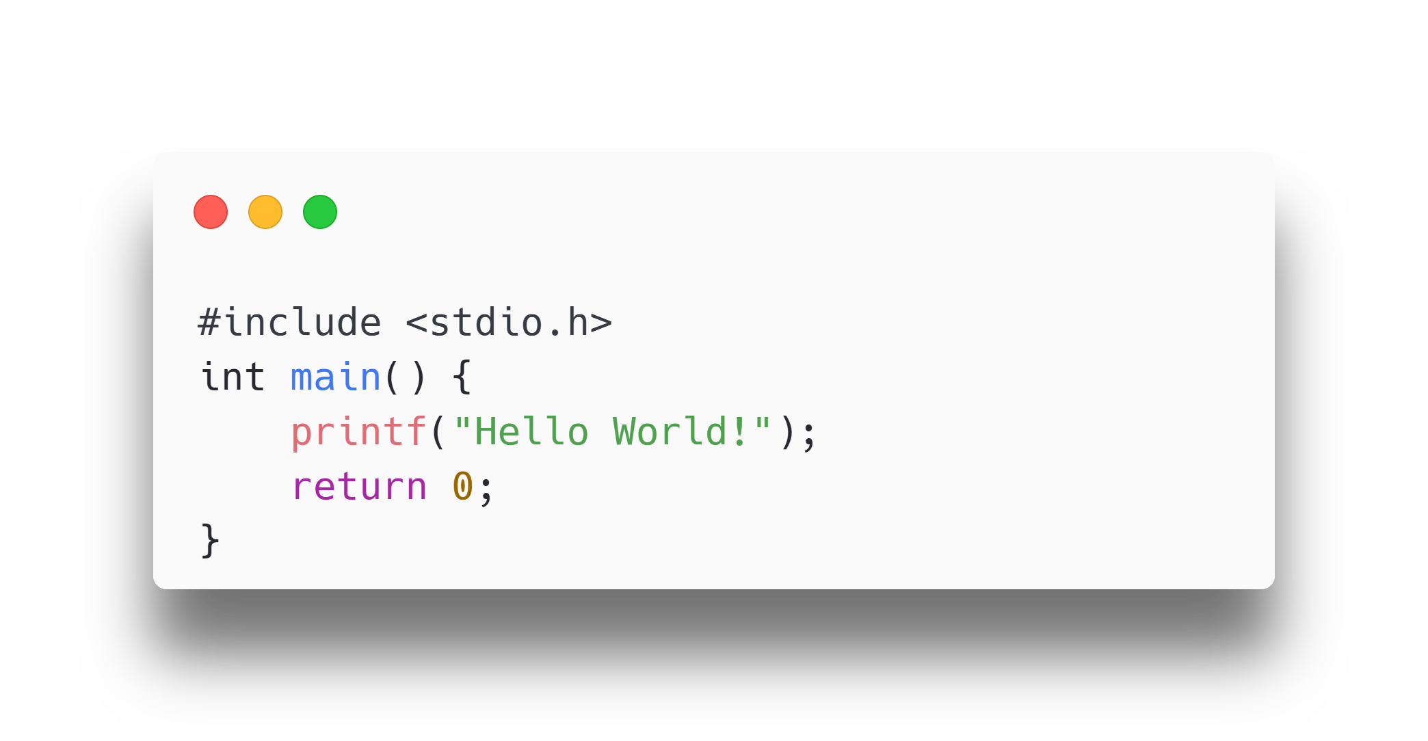
Basic C Code Example
Code:
Explanation:
- `#include <stdio.h>`: Header file library for input/output functions.
- `int main() {}`: Main function where the code execution begins.
- `printf("Hello World!");`: Prints "Hello World!" to the screen.
- `return 0;`: Ends the main function.

Slide 21
Statements in C
A computer program is a list of instructions executed by a computer.
In C, these instructions are called statements.
Example:
printf("Hello World!");
!Important: Every C statement ends with a semicolon `;`.

Slide 22
Many Statements Example
Example:
printf("Hello World!");
printf("Have a good day!");
return 0;
Explanation:
- First statement prints "Hello World!".
- Second statement prints "Have a good day!".
- Third statement ends the program successfully.

Slide 23
Use of Escape Sequence ‘ \n ’
Example:
printf("Hello World!");
printf(“\n”);
printf("Have a good day!");
Explanation:
First statement prints "Hello World!".
Second statement prints the next line.
Third statement prints "Have a good day!".

Slide 24
Header files
C Header files offer the features like library functions, data types, macros, etc. by importing them into the program with the help of a preprocessor directive “#include”.
Header files contain predefined standard library functions.
The .h extension is used for header files.
Included in the program using the #include directive.
Including Header Files
Syntax:
#include <filename.h>

Slide 25
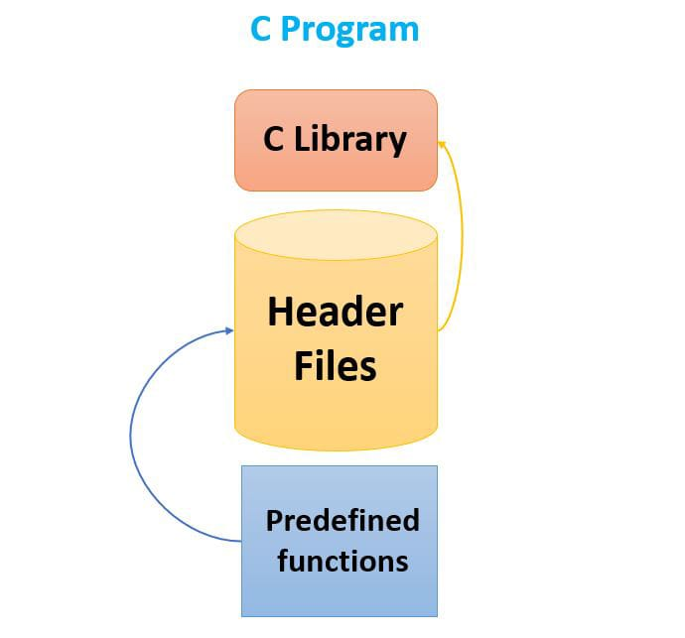
Header files
Standard Header Files
Header File | Description | Functions/Macros/ Variables
stdio.h | Input / Output functions | scanf(), printf(), fopen(), FILE
stdlib.h | General utility functions | atoi(), atof(), malloc()
math.h | Mathematics functions | sin(), cos(), pow(), sqrt()
string.h | String functions | strcpy(), strlen(), strcat()

Slide 26
Comments in C
A comment in C is a piece of text within the code that is ignored by the compiler, used to explain code and improve readability.
Types of Comments
Single-line Comments
Multi-line Comments

Slide 27
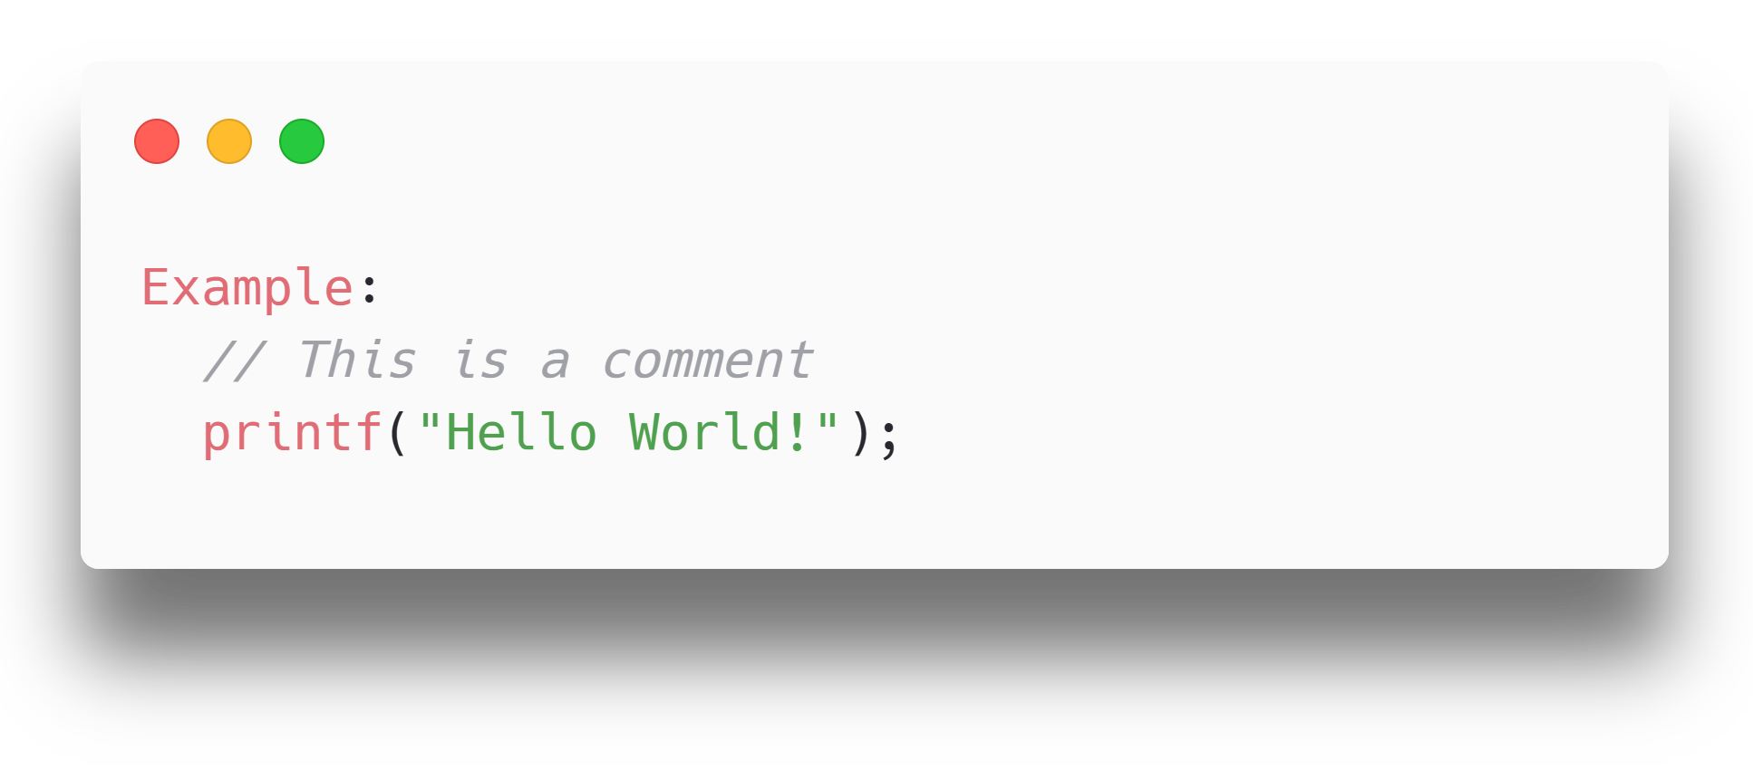
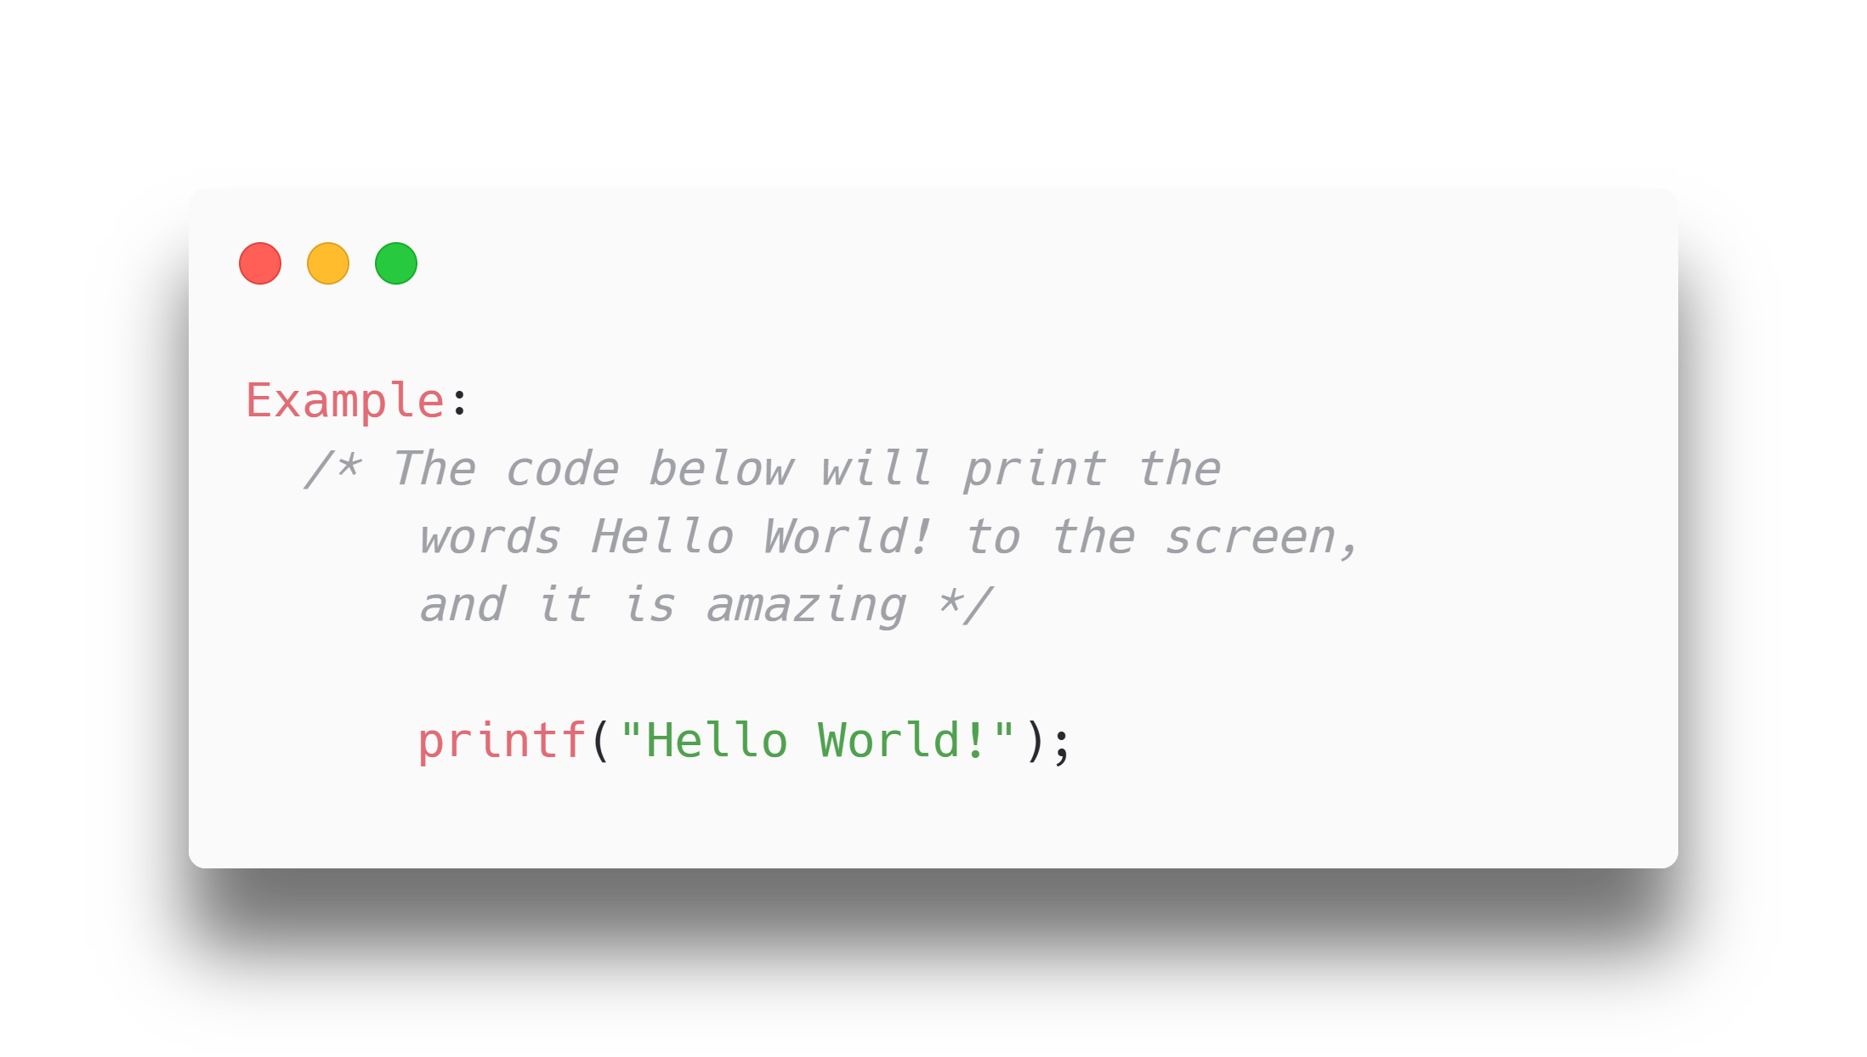
Types of Comments
2. Multi-line Comments
Start with /* and end with */
Text between /* and */ is ignored by the compiler
1. Single-line Comments
Start with two forward slashes (//)

Slide 28
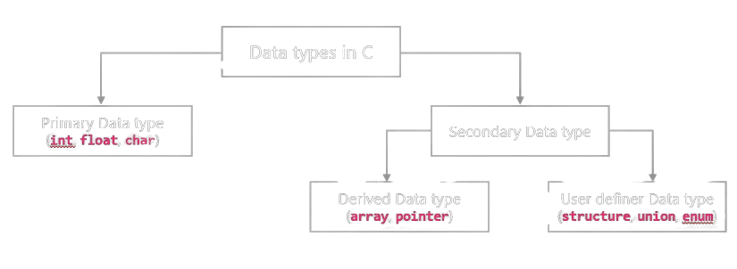
Data types

Slide 29
Primary Data Types
Primary data types are built in data types which are directly supported by machine.
They are also known as fundamental data types.
int:
int, datatype can store integer number which is whole number without fraction part such as 10, 105 etc.
C language has 3 classes of integer storage namely short int, int and long int. All of these data types have signed and unsigned forms.
Example: int a=10;

Slide 30
Primary Data Types
float:
float data type can store floating point number which represents a real number with decimal point and fractional part such as 10.50, 155.25 etc.
When the accuracy of the floating point number is insufficient, we can use the double to define the number. The double is same as float but with longer precision.
To extend the precision further we can use long double which consumes 80 bits of memory space.
Example: float a=10.50;

Slide 31
Primary Data Types
char:
Char data type can store single character of alphabet or digit or special symbol such as 'a', '5' etc.
Each character is assigned some integer value which is known as ASCII values.
Example: char a='a';
void:
The void type has no value therefore we cannot declare it as variable as we did in case of int or float or char.
The void data type is used to indicate that function is not returning anything.

Slide 32
Secondary Data types
Secondary data types are not directly supported by the machine.
It is combination of primary data types to handle real life data in more convenient way.
It can be further divided in two categories,
Derived data types: Derived data type is extension of primary data type. It is built-in system and its structure cannot be changed. Examples: Array and Pointer.
Array: An array is a fixed-size sequenced collection of elements of the same data type.
Pointer: Pointer is a special variable which contains memory address of another variable.

Slide 33
Secondary Data types
User defined data types: User defined data type can be created by programmer using combination of primary data type and/or derived data type. Examples: Structure, Union, Enum.
Structure: Structure is a collection of logically related data items of different data types grouped together under a single name.
Union: Union is like a structure, except that each element shares the common memory.
Enum: Enum is used to assign names to integral constants, the names make a program easy to read and maintain.

Slide 34
Data types
Example:
// Create variables
int a = 5; // Integer (whole number)
float b = 5.99; // Floating point num
char c = 'D'; // Character
// Print variables
printf("%d\n", a);
printf("%f\n", b);
printf("%c\n", c);
Format Specifier | Data Type | Example Output
%d or %i | int | 5
%f or %F | float | 5.99
%lf | double | 5.990000
%c | char | D
%s | string | "Hello"

Slide 35
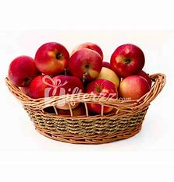
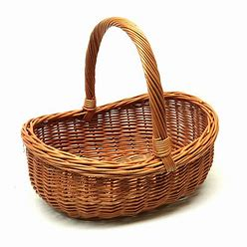
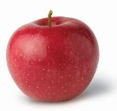


Variables in C
Syntax:
type variableName = value;
type is one of C types (such as int)
variableName is the name of the variable (such as x or myName)
The equal sign is used to assign a value to the
variable.
Example:
int myNum = 15;
Variables are containers for storing data values, like numbers and characters.
Data
Variable
Variable with data

Slide 36
Rules for naming variables
1. Contain letters, digits, and underscores.
2. Begin with a letter or an underscore.
3. Case-sensitive (myVar and myvar are different).
4. No whitespaces and special characters (e.g., !, #, %) except underscore( _ ) & dollar( $ ).

Slide 37
Rules for naming variables
5. Cannot use reserved words (e.g., int).
6. Camel Case:
The first word starts with either a lowercase or uppercase letter, and the following words start with an uppercase letter.
Examples: myVariableName, MyVariableName, iPhone, eBay.
7. Pascal Case (Upper Camel Case):
The first letter of each word, including the initial word, is capitalized.
Examples: MyVariableName, YouTube, PowerPoint.

Slide 38
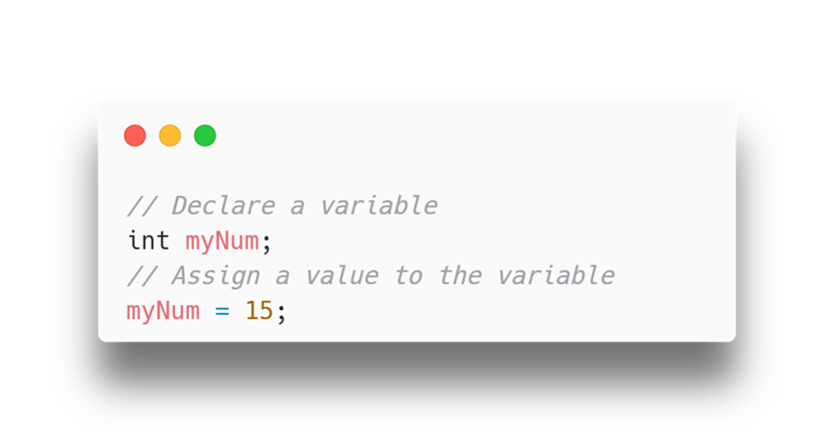
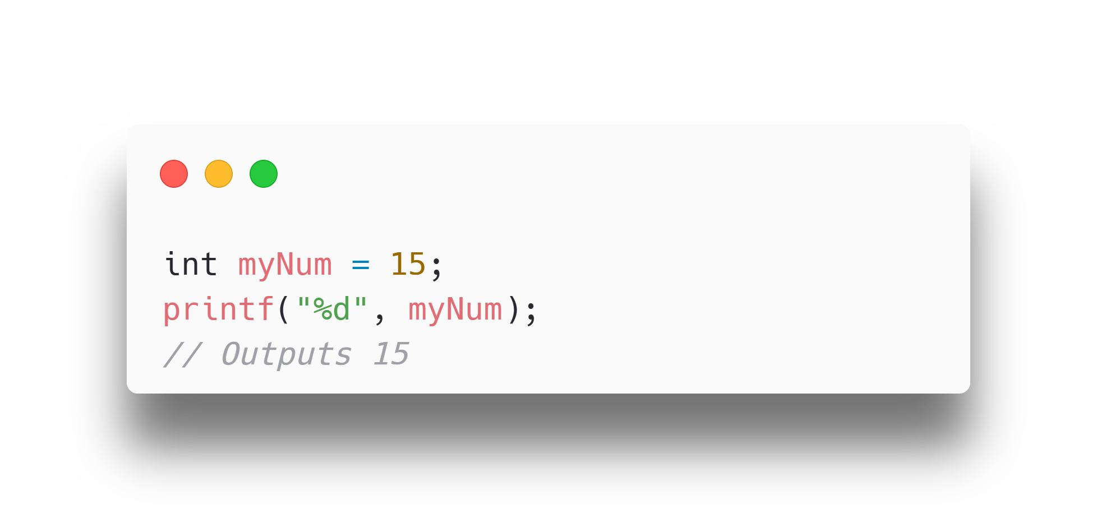
Variables in C
If you assign a new value to an existing variable, it will overwrite the previous value:
int myNum = 15; // myNum is 15 myNum = 10; // Now myNum is 10
You can also assign the value of one variable to another:
int myNum = 15; int myOtherNum = 23; // Assign the value of myOtherNum (23) to myNum myNum = myOtherNum; // myNum is now 23, instead of 15 printf("%d", myNum);
To declare more than one variable of the same type, use a comma-separated list:
int x = 5, y = 6, z = 50; printf("%d", x + y + z);
You can also declare a variable without assigning the value, and assign the value later:
Format specifiers are used together with the printf() function to tell the compiler what type of data the variable is storing. It is basically a placeholder for the variable value.

Slide 39
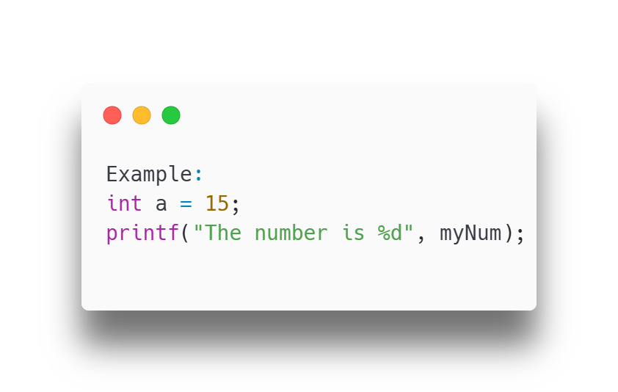
Outputting Variables
Use `printf()` to output values or print text.

Slide 40
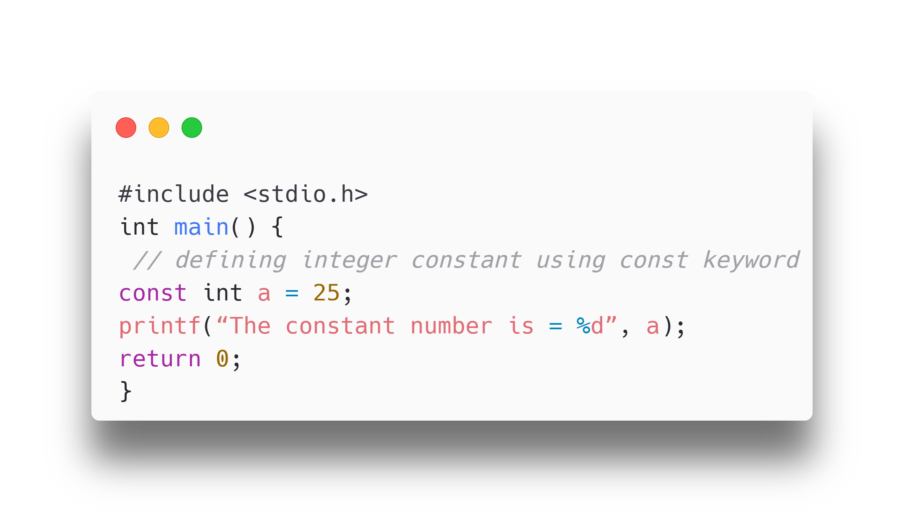
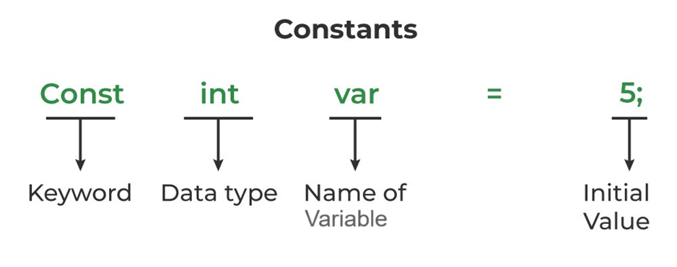
Constants in C
A constant in C is a variable that cannot be modified once it is declared in the program. We cannot make any change in the value of the constant variables after they are defined.
Syntax:
const data_type var_name = value;

Slide 41
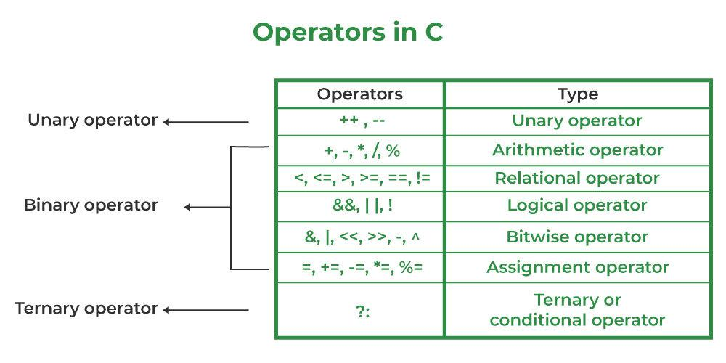
Operators
Operators are used to perform operations on variables and values.
Types of Operators
Arithmetic operators
Relational operators
Logical operators
Bitwise operators
Assignment operators

Slide 42
Arithmetic Operators
Operator | Name | Description | Example
+ | Addition | Adds together two values | x + y
- | Subtraction | Subtracts one value from another | x - y
* | Multiplication | Multiplies two values | x * y
/ | Division | Divides one value by another | x / y
% | Modulus | Returns the division remainder | x % y
Perform common mathematical operations.
Example:
int sum1 = 100 + 50; // 150 (100 + 50)
int sum2 = sum1 + 250; // 400 (150 + 250)
int sum3 = sum2 + sum2; // 800 (400 + 400)

Slide 43
Unary Operators
Operator | Name | Description | Example
++ | Increment | Increases the value of a variable by 1 | ++x
-- | Decrement | Decreases the value of a variable by 1 | --x
Perform Increment Or Decrement Operations
Example:
int sum1 = 100;
printf(sum1++);
Printf(++sum1);

Slide 44
Relational Operators
Operator | Name | Description | Example
== | Equal to | Returns 1 if the values are equal | x == y
!= | Not equal | Returns 1 if the values are not equal | x != y
> | Greater than | Returns 1 if the first value is greater | x > y
< | Less than | Returns 1 if the first value is lesser | x < y
>= | Greater than or equal to | Returns 1 if the first value is greater or equal | x >= y
<= | Less than or equal to | Returns 1 if the first value is lesser or equal | x <= y
Compare two values (or variables).
Example:
int x = 5;
int y = 3;
printf("%d", x > y);
// returns 1 (true) because 5 is greater than 3

Slide 45
Logical Operators
Operator | Name | Description | Example
&& | AND | Returns 1 if both statements are true | x < 5 && x < 10
|| | OR | Returns 1 if at least one of the statements is true | x < 5 || x < 10
! | NOT | Reverses the result, returns 0 if the result is 1 | !(x < 5 && x < 10)
Determine the logic between variables or values by combining multiple conditions.
Example:
if (x > 5 && x < 10)
printf("x is between 5 and
10\n");
if (x < 5 || x > 10)
printf("x is outside the range 5 to 10\n");

Slide 46
Bitwise Operator
Operator | Name | Description | Example
& | Bitwise AND | Performs a bitwise AND operation between two operands. | x & y
| | Bitwise OR | Performs a bitwise OR operation between two operands. | x|y
^ | Bitwise XOR | Performs a bitwise XOR operation between two operands. | x ^ y
~ | Bitwise NOT | Performs a bitwise NOT operation (inverts all bits) on the operand. | ~x
<< | Left Shift | Shifts the bits of the left operand to the left by the number of positions specified by the right operand. | x << 2
>> | Right Shift | Shifts the bits of the left operand to the right by the number of positions specified by the right operand. | x >> 2
Bitwise operators perform operations on the binary representations of integers.
Example:
int a = 4, b = 5;
printf("a & b :%d\n", a & b); printf("a | b :%d\n", a | b);
printf("a ^ b :%d\n", a ^ b);

Slide 47
Assignment Operators
Operator | Name | Description | Example
= | Assignment | Assigns the value on the right to the variable on the left | x = 5
+= | Addition Assignment | Adds the right operand to the left operand and assigns the result to the left operand | x += 3
-= | Subtraction Assignment | Subtracts the right operand from the left operand and assigns the result to the left operand | x -= 3
*= | Multiplication Assignment | Multiplies the right operand with the left operand and assigns the result to the left operand | x *= 3
/= | Division Assignment | Divides the left operand by the right operand and assigns the result to the left operand | x /= 3
%= | Modulus Assignment | Takes modulus using two operands and assigns the result to the left operand | x %= 3
Assign values to variables.
Example:
int x = 10;
x += 5; // x is now 15

Slide 48
Ternary Operator
We will See it in Control Structure….

Slide 49
Type conversion
Type conversion is the process of converting the value of one data type to another.
There are two types of type conversion in C:
1. Implicit Conversion (Automatic)
2. Explicit Conversion (Manual)

Slide 50
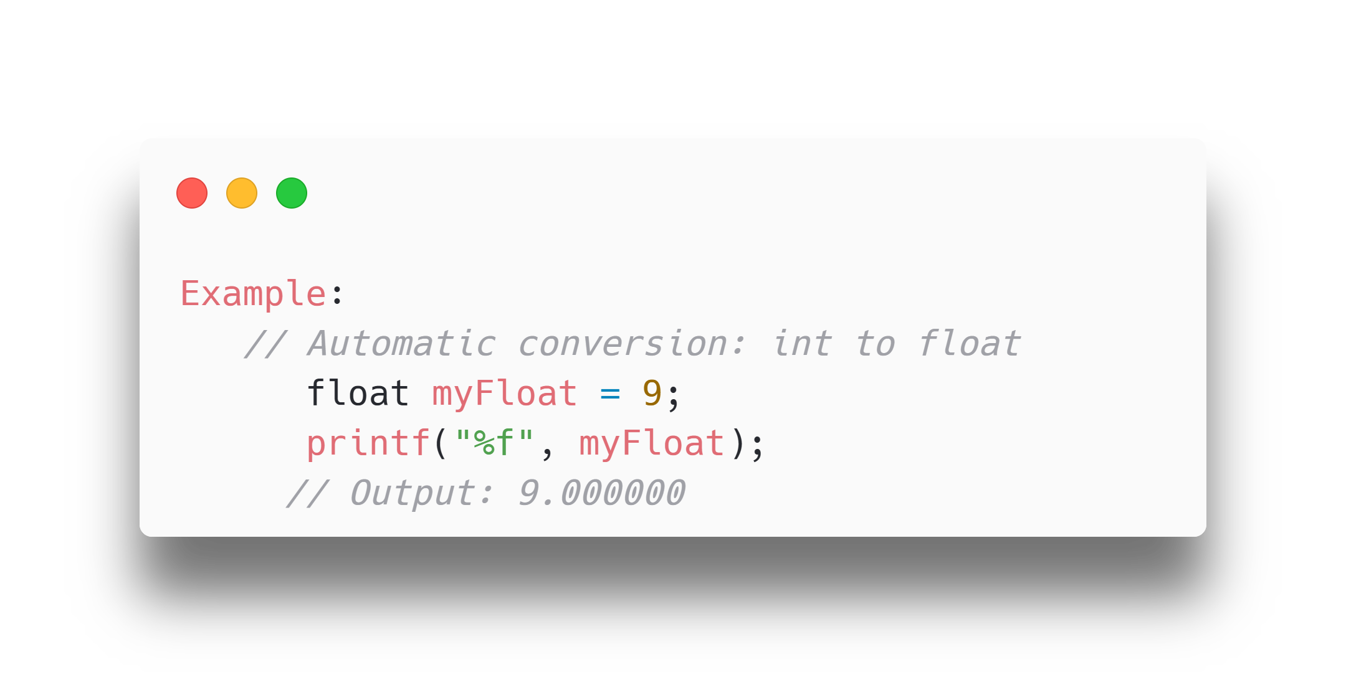
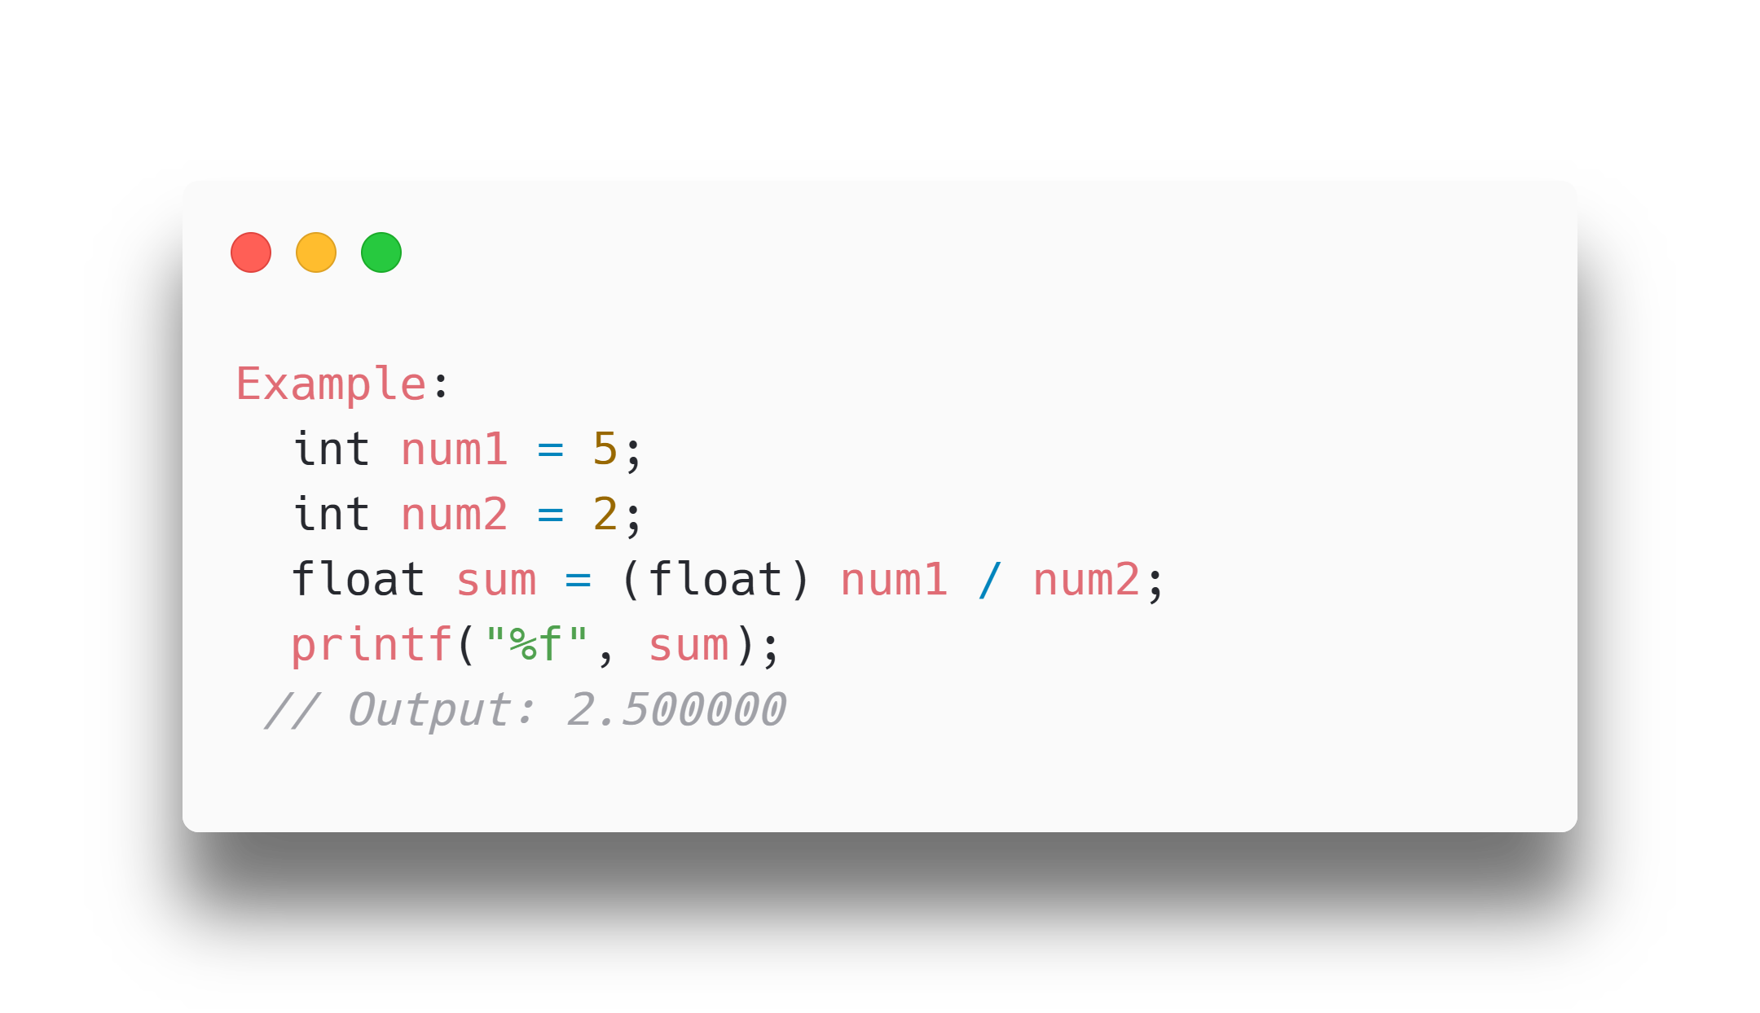
Types of Type Conversion
Explicit Conversion
Explicit conversion is done manually by the programmer using casting.
Syntax: Place the type in parentheses before the value.
Implicit Conversion
Implicit conversion is automatically performed by the compiler when you assign a value of one type to another.

Slide 51
I/O functions
List of I/O Functions
printf() | Outputs formatted text to the console.
scanf() | Reads formatted input from the console.
fgets() | Reads a line of text from a file or input stream.
fputs() | Writes a string to a file or output stream.
getchar() | Reads a single character from the standard input.
putchar() | Writes a single character to the standard output.
Input/Output (I/O) functions in C are used to perform input and output operations.
They are part of the C Standard Library and are declared in the <stdio.h> header file.

Slide 52
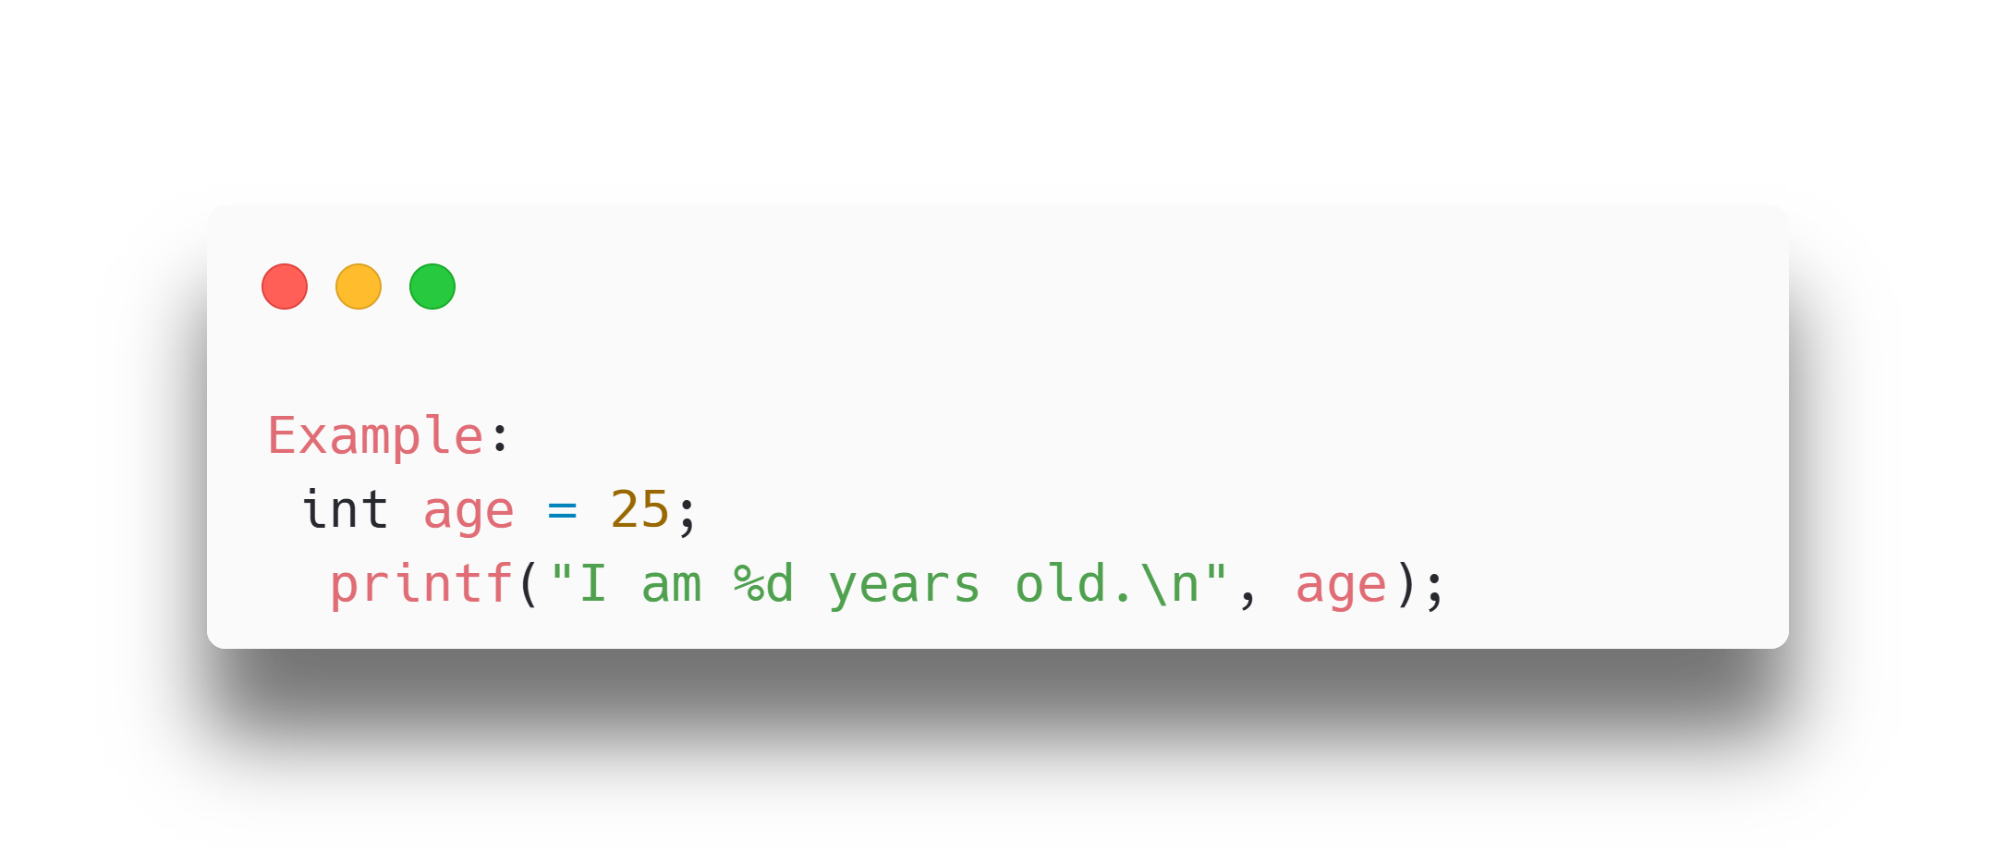
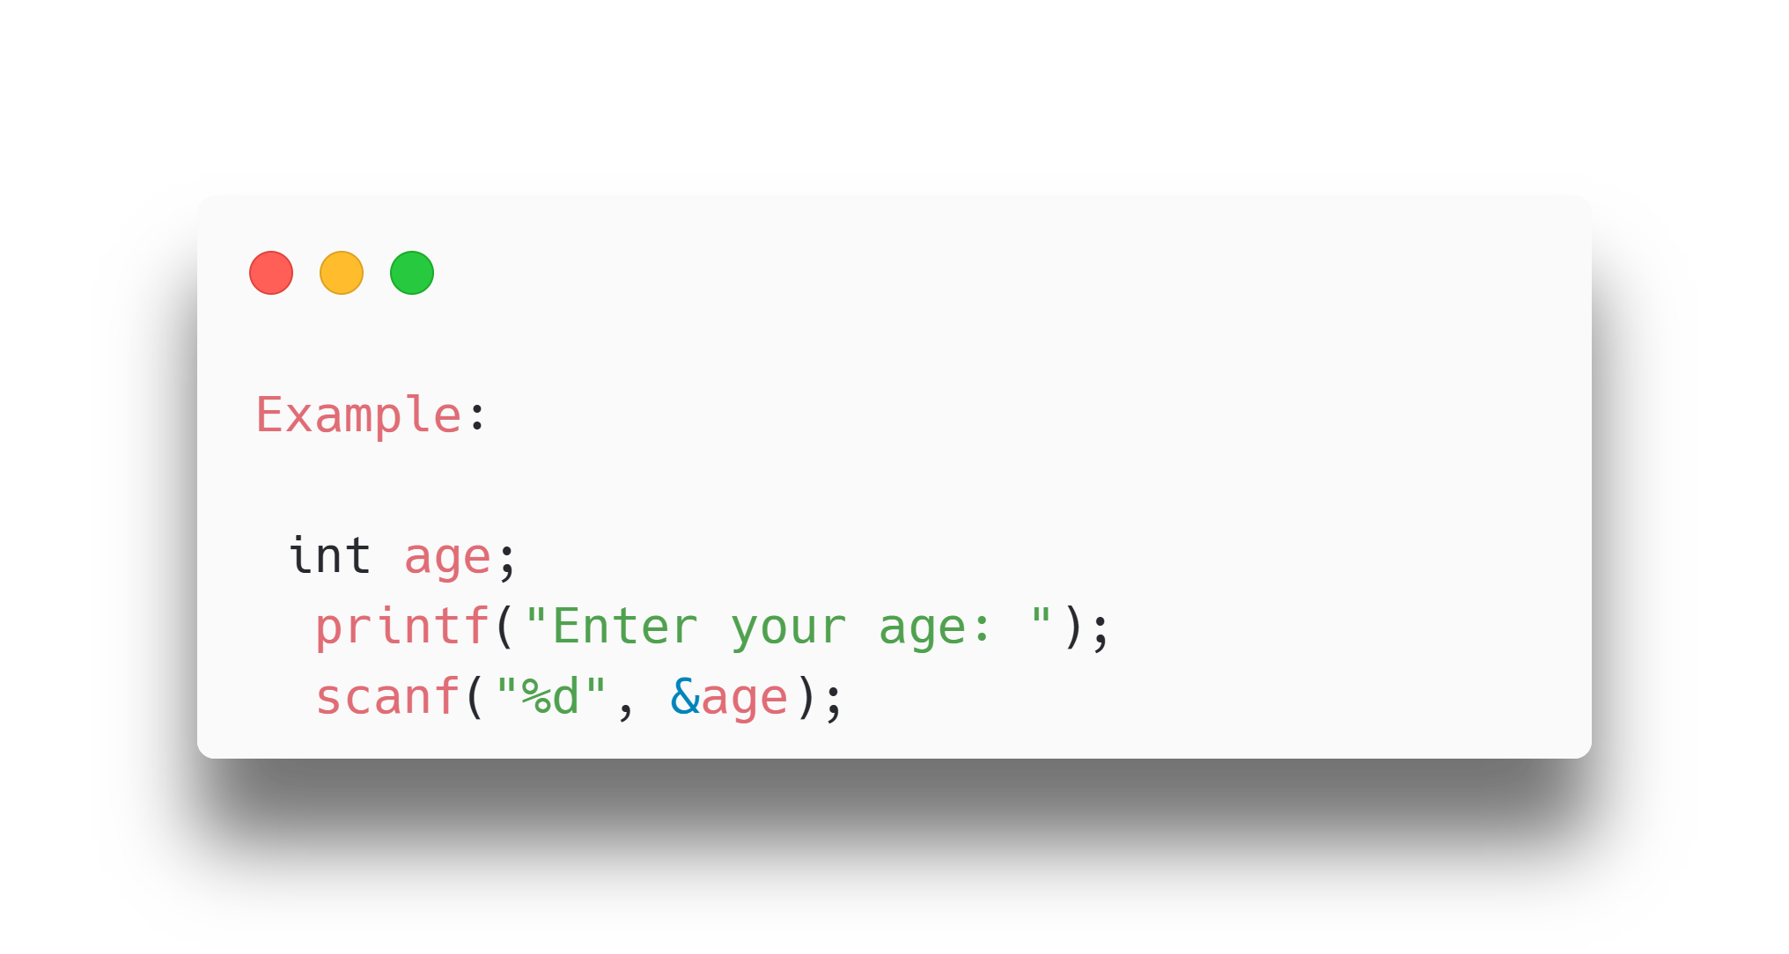
I/O Functions Example
printf()
Used for outputting formatted text to the console.
Syntax:
printf("format string", arguments);
scanf()
Used for reading formatted input from the console.
Syntax:
scanf("format string", &variables);

Slide 53
Thank You..!!
See You In The Next Session..!!

